Slide 1

A Project
presentation on
Hotel management System
Presented by:
APURVA CHIMOTE(1120)
ANKITA DHAVALE(1119)
Mr.Prashant Karhale Mr.Kashinath Patil
Centre Coordinator Project Guide
Institute for Advanced Computing & Software Development (IACSD)

Slide 2
Today’s discussion aims …
—Introduction
—Motivation
—Objectives
__Proposed System
—System Architecture
—Description of system
—Applications
—Advantages and Disadvantages
__Screenshots
—Conclusions
—References

Slide 3
Introduction
Hotel Management System is a web-based hotel management software. The software features include booking management, booking calendar, check ins & check outs management, payment and accounting document reports.
Interactive GUI and the ability to manage various hotel bookings and rooms make this system very flexible and convenient. This application gives him the power and flexibility to manage the entire system from a single online system. Customer can view and book room online. Hotel Management project provides room booking, staff management.

Slide 4
Motivation
This online hotel management solution is fully functional and flexible.
It is very easy to use.
This online hotel management system helps in back hotel administration by streamlining and standardizing the procedures.
It saves a lot of time, and manage budgets.
Eco-friendly: The monitoring of the hotel management and the overall business becomes easy.
The application acts as an office that is open 24/7.
It increases the efficiency of the management at offering quality services to the customers. It provides custom features development and support with the application.

Slide 5
Objectives
The main perspective of this project is to provide a online platform for Booking of hotel’s room with secure payment option and easy done.
This is basically similar to going hotel and booking that we have. But with the use of computers for creating online platform, it will be easy for people to book hotel at any time.

Slide 6
Proposed System
The hotel management system provides the quality service to the end user. This project aims at creating on Hotel Management System which can be used by Admin and Customers. The admin to advise/publish the availability of rooms in different hotels and customers are checking the availability of room in required hotel. Customers should be able to know the availability of the rooms on a particular date to reserve in hotel. They should be able to reserve the available rooms according to their need in advance. To make their stay comfortable.

Slide 7
Description of System
This architecture diagram gives us the flow of the algorithm and overall functionality of the system.
The user of the system selects the hotel and the further process gets start.
This module provides the functionality for customers to book their room and supply necessary details. Users of the system, namely customers, must be provided the following functionality:
Create an account.
Log in to the system.
Navigate to the hotel & rooms gallery.
Book the suitable room.

Slide 8
Applications
This system will be implemented as a web application. We have created an Hotel Management System web application where a gallery of Hotels & Rooms will be displayed.
As any other Hotel reservation web application, this system will give many options to the user to book or just view a Hotel & Room.

Slide 9
Advantages / Disadvantages
Advantage :
It provides the good publishing services to end users. Means the admin can publish the availability of rooms in different hotels and this information visible at users/customer side. So, it providing the good publishing process.
The central objective of hotel management is to provide online facility for booking rooms.
This project provides high security to Admin and user information
This software can manage and keep records of hotel.
Disadvantage :
In the existing system, only provides the information about particular hotel and only some of the hotels has possibility to reserve the rooms.
The previous system was failure to publish the room’s availability of multiple hotels.
And, It is failure to provide defence to admin and user information

Slide 10
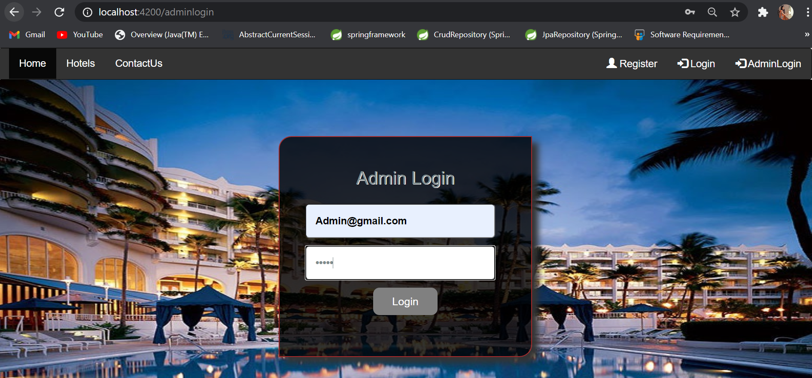
Screenshots

Slide 11
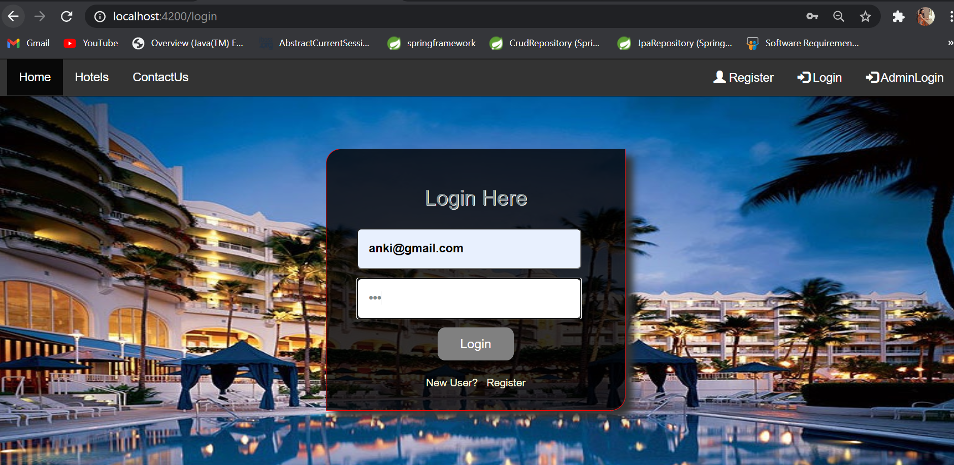
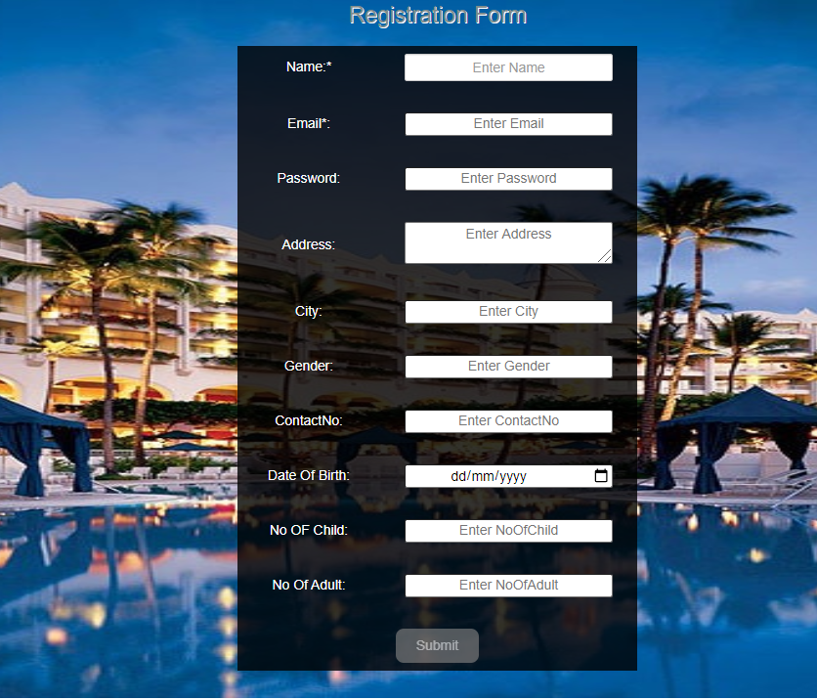
Login/Registration

Slide 12
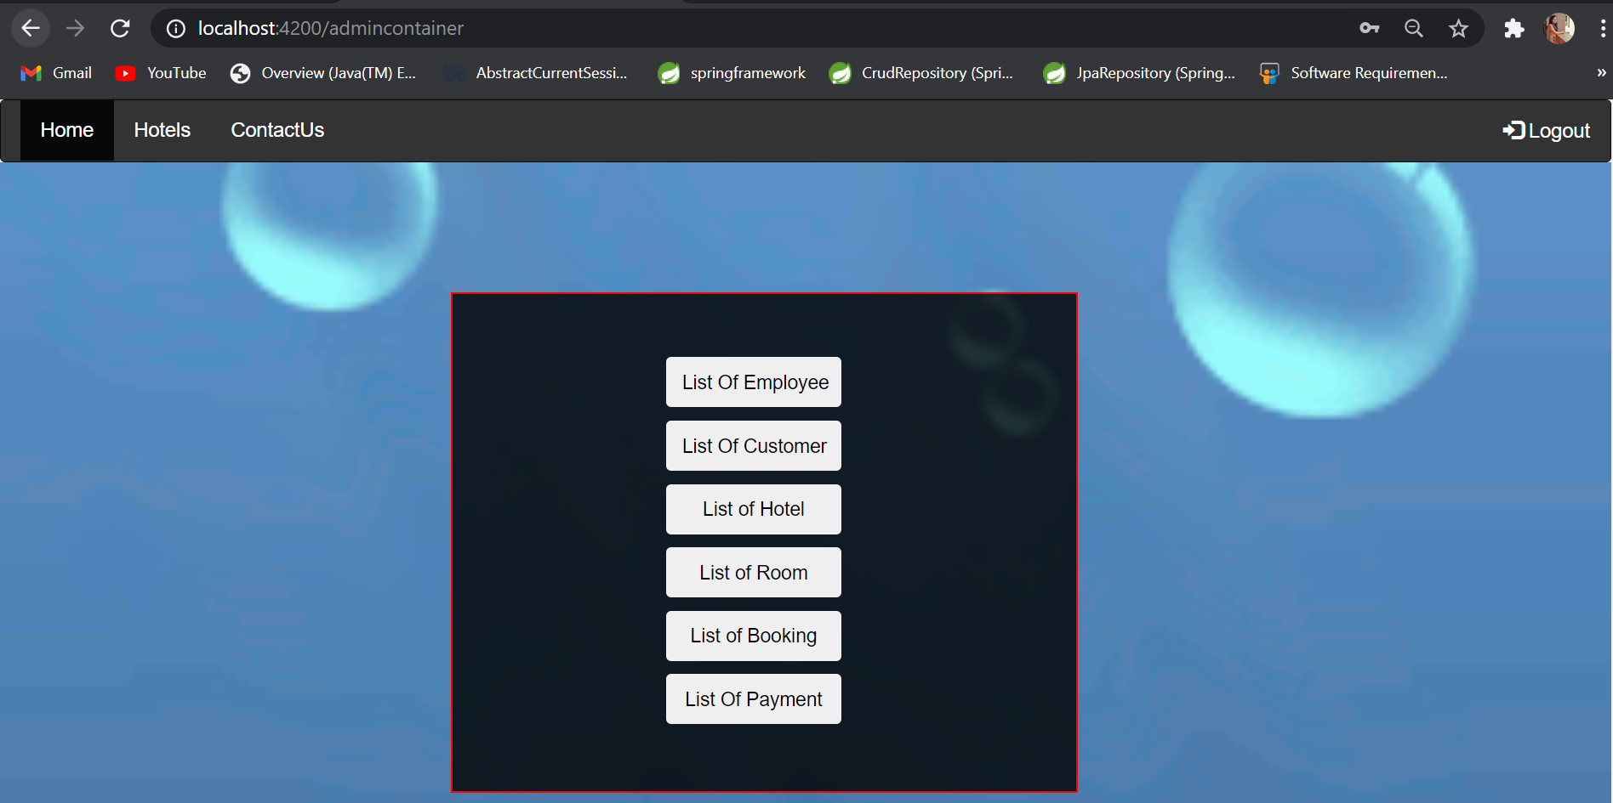
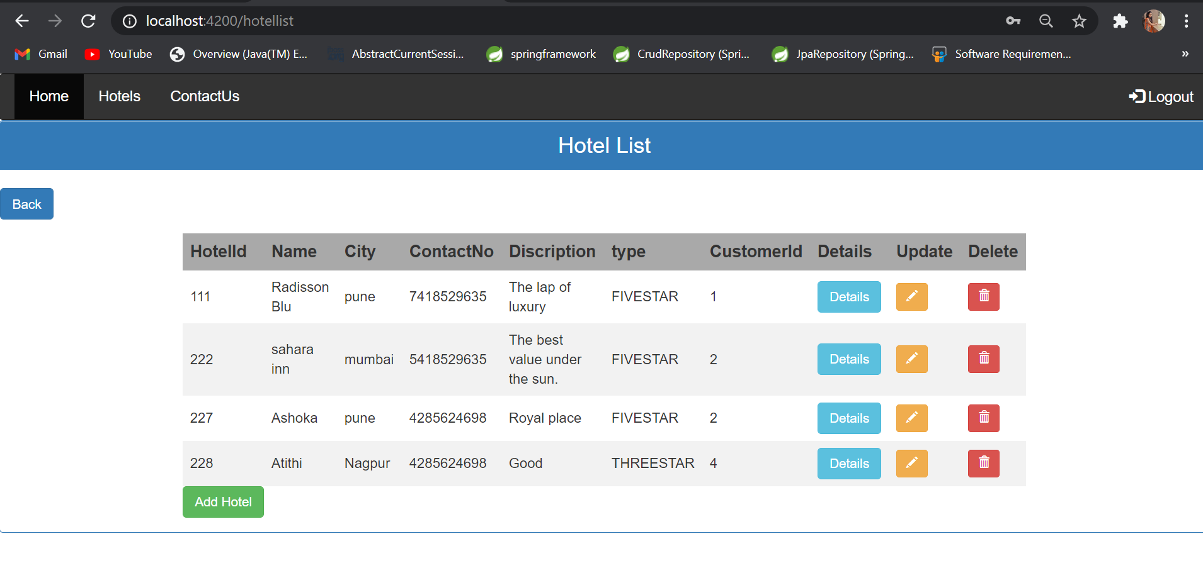
Admin Panel

Slide 13
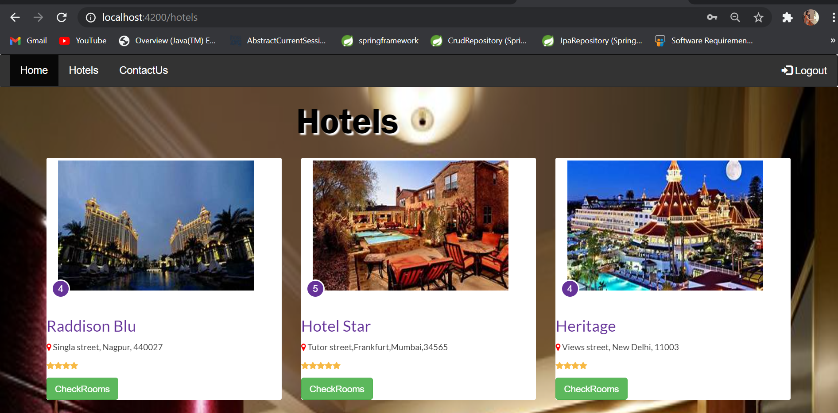
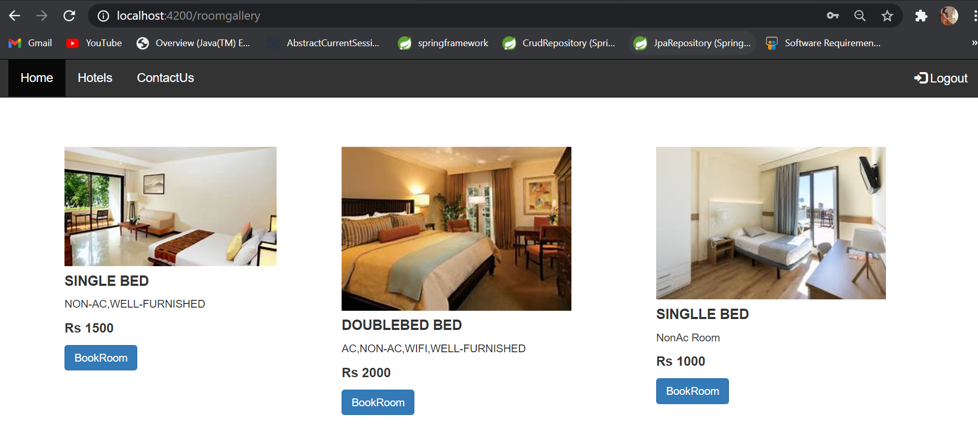
Customer View

Slide 14
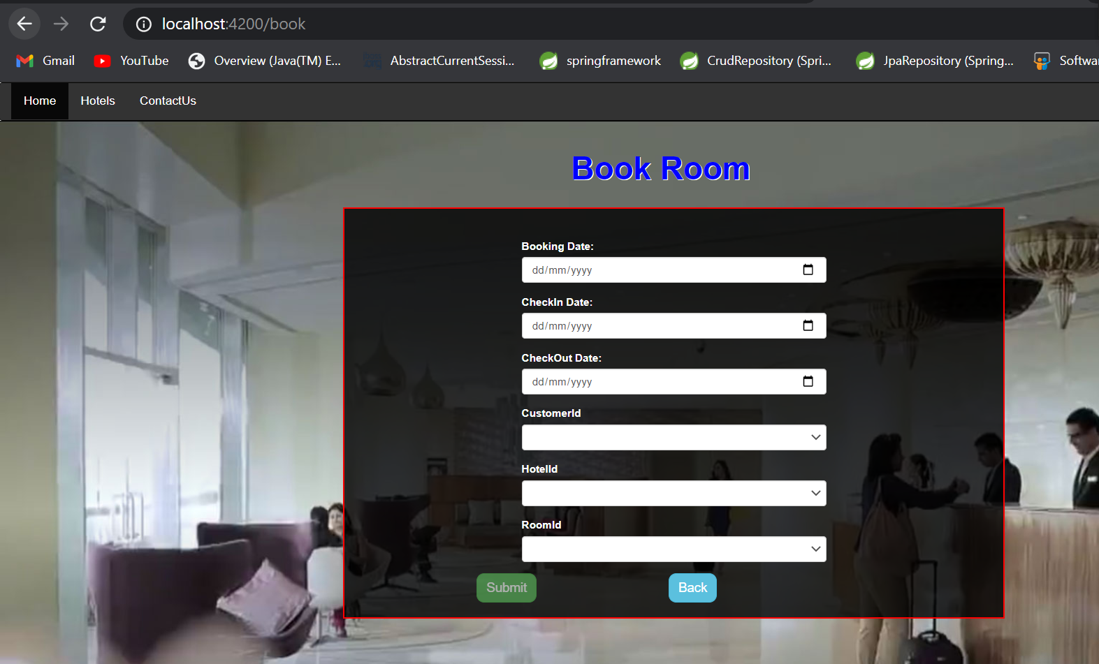
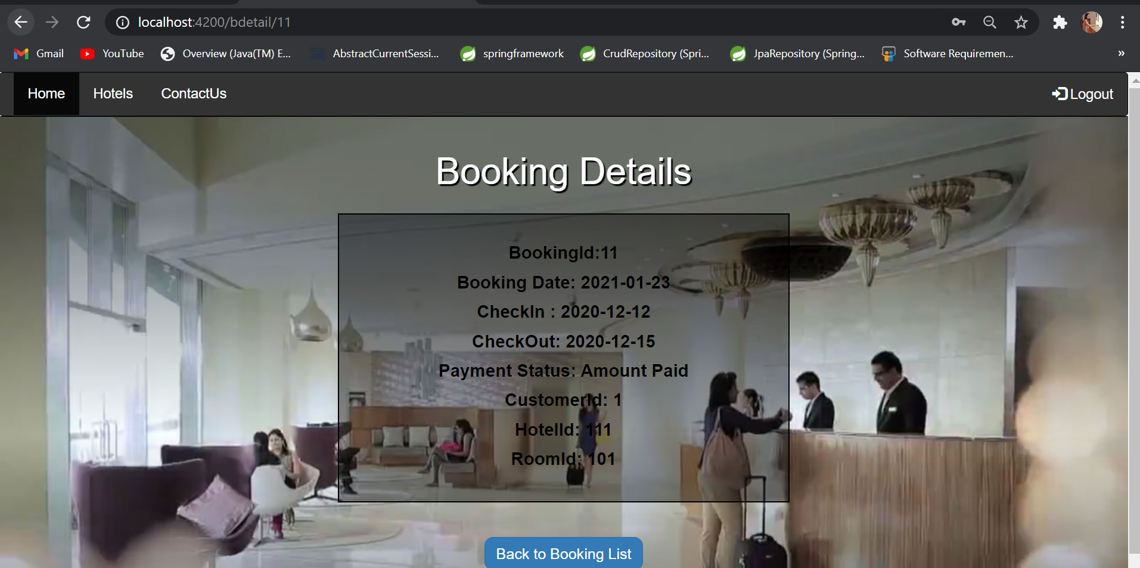
Booking

Slide 15
Conclusion
In hotel management system, We have developed a secure , user-friendly Hotel Management System. This system can take care of each member whether its admin or customer. This System will help them to properly manage their hotel and help in growth without creating and hassle. This system is completely secure since every user is provided with user id and Password so there is no chance of any unauthorized access, online Payment, Booking and cancellation make it easier to use . So, using this system will help in reducing the time and provide more facility for customer to like hotel and visit again and again.

Slide 16
References
[1] Core Java And Advanced Java With Crud Operation Lectures Conducted by Madhura Mam.
[2] Java By Budo Timothy “Understanding Object- Oriented Programming with JAVA” . Pearson,1999
[3] Java By Balgurusamy E “ Programming with JAVA, A Primer” Tata Mcgraw Hill,2006.
[4] Angular Lectures

Slide 17
Thank You!!!

